Slide 1
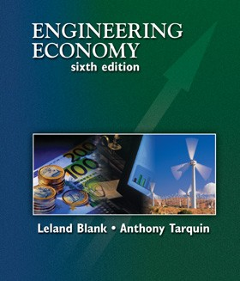

Developed By:
Dr. Don Smith, P.E.
Department of Industrial Engineering
Texas A&M University
College Station, Texas
Executive Summary Version
Chapter 17
After-Tax Economic Analysis
Notes:
At this point:
1. Introduce yourself - your students are likely to want to know something about your qualifications and interests - overall, where you are coming from.
2. Have students introduce themselves. Ask why they are taking this class. If you are fortunate enough to have a Polaroid camera, take pictures of each student for later posting on a class “board” so both they and you get to know each other.
3. Discuss both choice of textbook and development of syllabus.
4. If you are expecting students to work in teams, at east introduce the choice of team members. If at all possible, have students participate in a team building or team study exercise. It works wonders. Most student have been told to work in teams in prior classes, but have never examined exactly what a team is and how it works. One hour spent in a team building/examination exercise saves many hours and avoids many problems later on.

Slide 2
LEARNING OBJECTIVES
Terminology and rates
CFBT and CFAT
Taxes and depreciation
Depreciation recapture and capital gains
After-tax analysis
Spreadsheets
After-tax replacement
Value-added analysis
Taxes outside the United States

Slide 3
Sct 17.1 Income Tax Terminology and Relations for Corporations (and Individuals)
Gross Income
  Total income for the tax year from all revenue producing function of the enterprise.
    Sales revenues,
    Fees,
    Rent,
    Royalties,
    Sale of assets
Income Tax
The total amount of money transferred from the enterprise to the various taxing agencies for a given tax year.
  Federal corporate taxes are normally paid at the end of every quarter and a final adjusting payment is submitted with the tax return at the end of the fiscal year.
  This tax is based upon the income producing power of the firm.

Slide 4
Terms - continued
Operating Expenses
  All legally recognized costs associated with doing business for the tax year.
  Real cash flows,
  Tax deductible for corporations:
    Wages and salaries
    Utilities
    Other taxes
    Material expenses
    etc.
Taxable Income
  Calculated amount of money for a specified time period from which the tax liability is determined.
  Calculated as:
  TI = Gross Income – expenses – depreciation
  TI = GI – E – D

Slide 5
Terms - continued
Tax rate T
  A percentage or decimal equivalent of TI.
For Federal corporate income tax T is represented by a series of tax rates.
The applicable tax rate depends upon the total amount of TI.
Taxes owed equals:
  Taxes = (taxable income) x (applicable rate)
  = (TI)(T).
Net Profit After Tax (NPAT)
  Amount of money remaining each year when income taxes are subtracted from taxable income.
  NPAT = TI – {(TI)(T)}
= (TI)(1-T)
Equivalent tax rate T_{e} combines federal and local rates:
T_{e} = state rate + (1 state rate)(federal rate)

Slide 6
U.S. Individual Federal Tax Rates (2003)
Taxable Income, $
Tax Rate (1) | Filing Single (2) | Filing Married and Jointly (3)
0.10 | 0-7,000 | 0-14,000
0.15 | 7,001-28,400 | 14,001-56,800
0.25 | 28,401-68,800 | 56,801-114,650
0.28 | 68,801-143,500 | 114,651-174,700
0.33 | 143,501 – 311,950 | 174,701-311,950
0.35 | Over 311,950 | Over 311,950

Slide 7
Basic Tax Equations - Individual
Gross Income
  GI = salaries + wages + interest and dividends + other income
Taxable Income
  TI = GI – personal exemptions – standard or itemized deductions
Tax
  T = (taxable income)(applicable tax rate)

Slide 8
Sct 17.2 Before-Tax and After-Tax Cash Flow
NCF = cash inflows – cash outflows
Cash Flow before Tax (CFBT)
  CFBT = gross income – expenses – initial investment + salvage value
  = GI – E – P + S
Cash Flow After Tax (CFAT)
  CFAT = CFBT – taxes
Add Depreciation
  CFAT = GI – E – P + S – (GI – E – D)(T_{e})
An evaluation format
  See Table 17 – 3 and Example 17.3 for a computational format

Slide 9
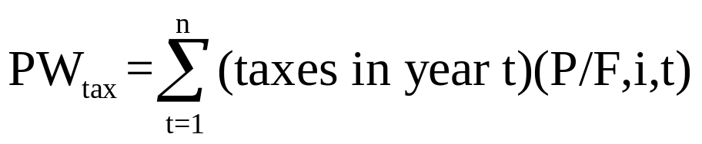
Sct 17.3 Effect on Taxes of Different Depreciation Methods and Recovery Periods
Criteria used to compare different depreciation methods – compute ---
Objective – Minimize the PW of future taxes paid owing to a given depreciation method
  The total taxes paid are equal for all depreciation models
  The PW of taxes paid is less for accelerated depreciation methods
  Shorter depreciation periods result in lower PW of future taxes paid over longer time periods
See Examples 17.4 and 17.5

Slide 10
Sct 17.4 Depreciation Recapture and Capital Gains (Losses) for Corporations
Capital gain (CG)
  CG = selling price – first cost
  CG = SP – P
Depreciation Recapture (DR)
  DR = selling price_{year t} – book value_{time of sale}
  DR – SP – BV_{t}
Capital Loss (CL)
  CL = book value – selling price
  CL = BV_{t} - SP

Slide 11
DR Summary - Outcomes
For and AT study the tax effect is:
If SP at time of sale is..
The CG, DR or CL is:
SP₁
CG
CG: Taxed at T_{e} after any CL offset
First Cost P
plus
SP₂
DR
DR: taxed at T_{e}
DR
Book Value BV_{t}
SP₃
CL
CL: Can only offset CG
Zero, $0
DR occurs when a productive asset is sold for more than its current BV

Slide 12
General TI Equation – for Corporations
The basic TI equation is:
TI = GI – E – D + DR + CG – CL
The basic spreadsheet format is
Year | GI | E | P | DEPR | BV | TI | Taxes
0
1
2
…
n
See Figure 17-4 and associated Example 17.6

Slide 13
Sct 17.5 After-Tax PW, AW, and ROR Evaluation
One project
  Apply PW or AW = 0
  Accept the project if after-tax MARR is met or exceeded
Two or More Projects
  Select the alternative with the largest PW or AW value
  Assume discounting occurs at the firm’s after-tax MARR rate
See Example 17.7

Slide 14

ROR Analysis
The Before-tax ROR
For ROR analysis -- review Chapter 8
Selection rules
  Apply incremental ROR
  Select the one alternative that requires the largest initial investment provided the incremental investment is justified relative to another justified alternative

Slide 15
Sct 17.6 Spreadsheet Applications –
After-Tax Incremental ROR Analysis
Two spreadsheet examples for after-tax ROR are presented
Examples 17.10 and 17.11

Slide 16
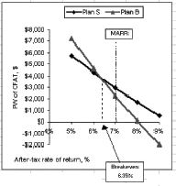
Example 17.10 – Comparison of S and B
The interest rate at
which the two
alternatives are
economically
equal (6.36%)

Slide 17
Sct 17.7 After-Tax Replacement Study
After-tax treatment of a replacement problem will generate a different data set than a before-tax replacement analysis
Year of replacement
  Could have DR, CG, CL situations
  After-tax replacement considers
    Depreciation
    Operating expenses
See Examples 17.12 and Table 17-6 for the formats
After-tax replacement analysis is more involved
An after-tax analysis could reverse a before-tax analysis on some problems

Slide 18
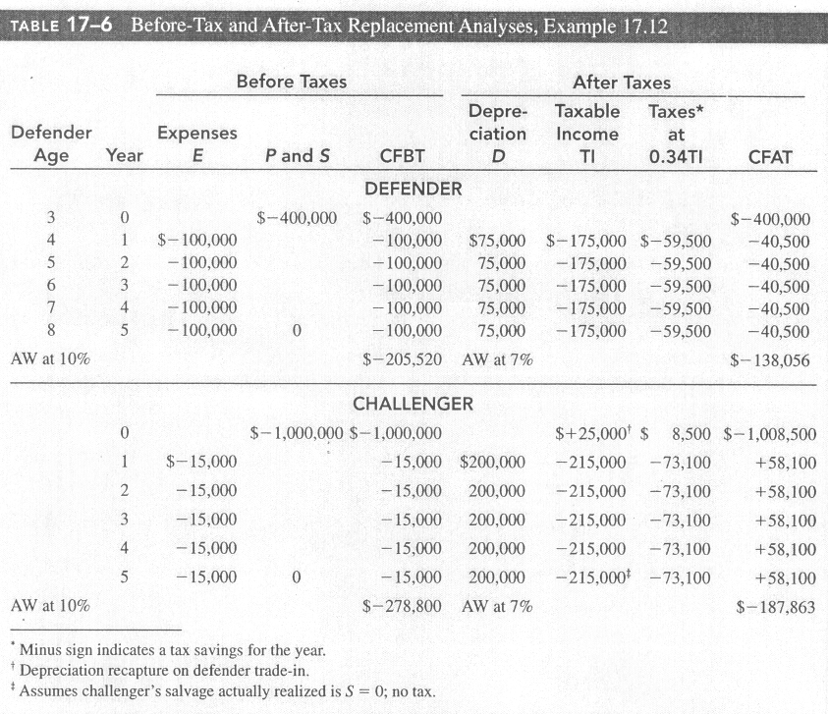
Format for After-Tax Replacement
Analysis with a 5-year straight line depreciation method applied

Slide 19
Warnings . . .
Always beware of using the ROR method for selecting from among alternatives.
DO NOT use computed ROR!
  This means the ROR computed on each separate investment alternative.
  Rather, form the incremental cash flow and make a determination on the Δi* value.
Need to design a spreadsheet model to effectively evaluate.

Slide 20
Sct 17.8 After-Tax Value Added Analysis
Value added is a term to indicate that a product or a service:
  Has added value to the consumer or buyer.
  Popular concept in Europe;
  Value-added taxes are imposed in Europe on certain products and paid to the government.
Rule:
  The decision concerning an economic alternative will be the same for a value added analysis and a CFAT analysis.
  Because, the AW of economic value added estimates is the same as the AW and CFAT estimates!

Slide 21
Value Added
To start, apply Eq. 17.3:
  NPAT = Taxable Income – taxes
  NPAT = (TI)(1-T)
Value added or Economic Value Added ( EVA) is:
  The amount of NPAT remaining after removing the cost of invested capital during the time period in question.
EVA indicates the project’s contribution to the net profit of the corporation after taxes have been paid.
The cost of invested capital is normally the firm’s after-tax required MARR value.
One multiplies the after-tax MARR by the current level of capital (investment).
Charge interest on the unrecovered capital investment at the after-tax MARR rate.

Slide 22
Value Added
Recall, firms often have two sets of books relating to depreciation:
  One for tax purposes and,
  One for internal management use. (book depreciation).
  For EVA, book depreciation is more often used.
    More closely represent the true rate of usage of the assets in question.
The annual EVA is the NPAT remaining on the books after removing the cost of invested capital during the year.
EVA indicates the project’s contribution to the net profit after taxes
EVA = NPAT – cost of invested capital
= NPAT – (after-tax interest book rate)(book value in year t-1)
EVA = TI(1-T_{e}) – (i)(BV_{t-1})

Slide 23
Sct 17.9 After-Tax Analysis for International Projects - Canada
Canada
  Depreciation – DB or SL with ½ yr convention
  Capital Cost Allowance (CCA)
  Standard recovery rates as in US
  Expenses – deductible in calculating TI
    Expenses related to capital investment are not deductible and are handles under CCA

Slide 24
Mexico
SL method with inflation indexing
Assets generally classified with annual recovery rates that vary
  5% for machinery to 100% for environmental assets
Profit tax with most expenses deductible
Tax of Net Assets (TNA) of 1.8% of the average value of assets locating in Mexico

Slide 25
Japan
Depreciation – SL or DB with 95% of the unadjusted basis used
Class and life – 4 to 24 years by law; up to 50 years for certain structures
Expenses are deductible

Slide 26
Chapter Summary
After-tax (AT) analysis is a more thorough approach in the evaluation of industrial projects
In some cases, AT analysis will show a reversal in before-tax decision, but not always
Tax rates in the US are graduated – higher taxable incomes pay higher taxes
Operating expenses are tax deductible
Depreciation amounts represent non-cash flows -- but do generate tax savings

Slide 27
Summary - continued
In the US, the MACRS method is required on federal corporate tax returns and recovery lives are mandated by law and by class
In replacement analysis, the impact of depreciation recapture, capital gain or loss is incorporated into the analysis
For AT replacement, the decision to replace will generally follow the before-tax analysis
AT replacement will show substantially different CFAT than the before-tax analysis

Slide 28
Chapter 17
End of Set

